Slide 1
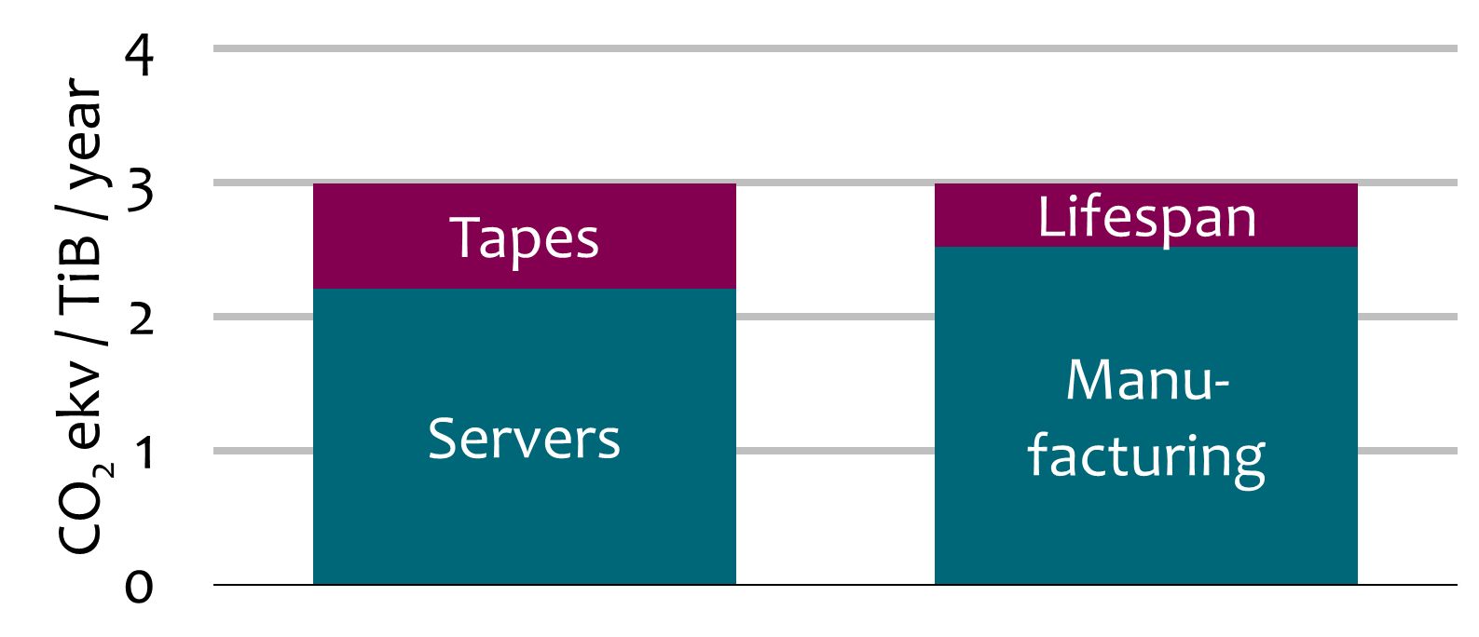
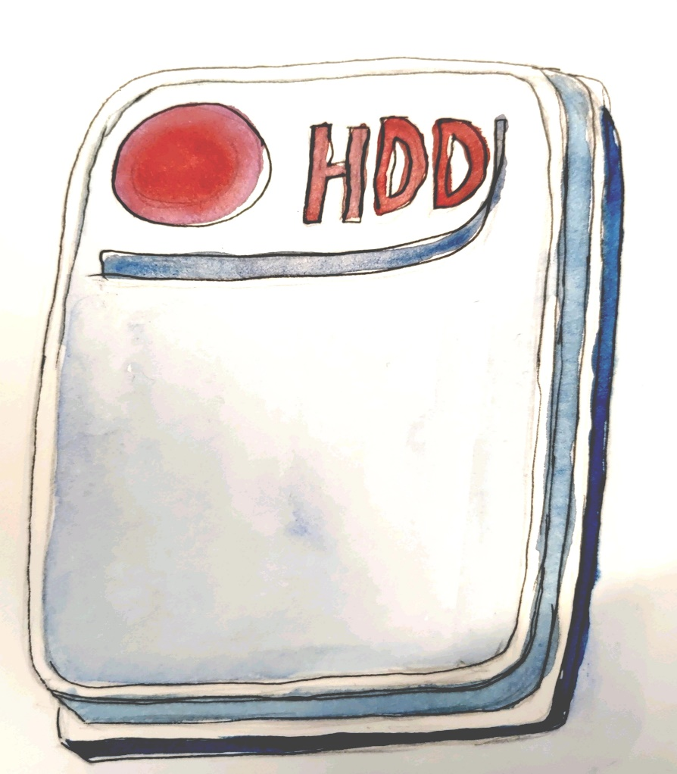
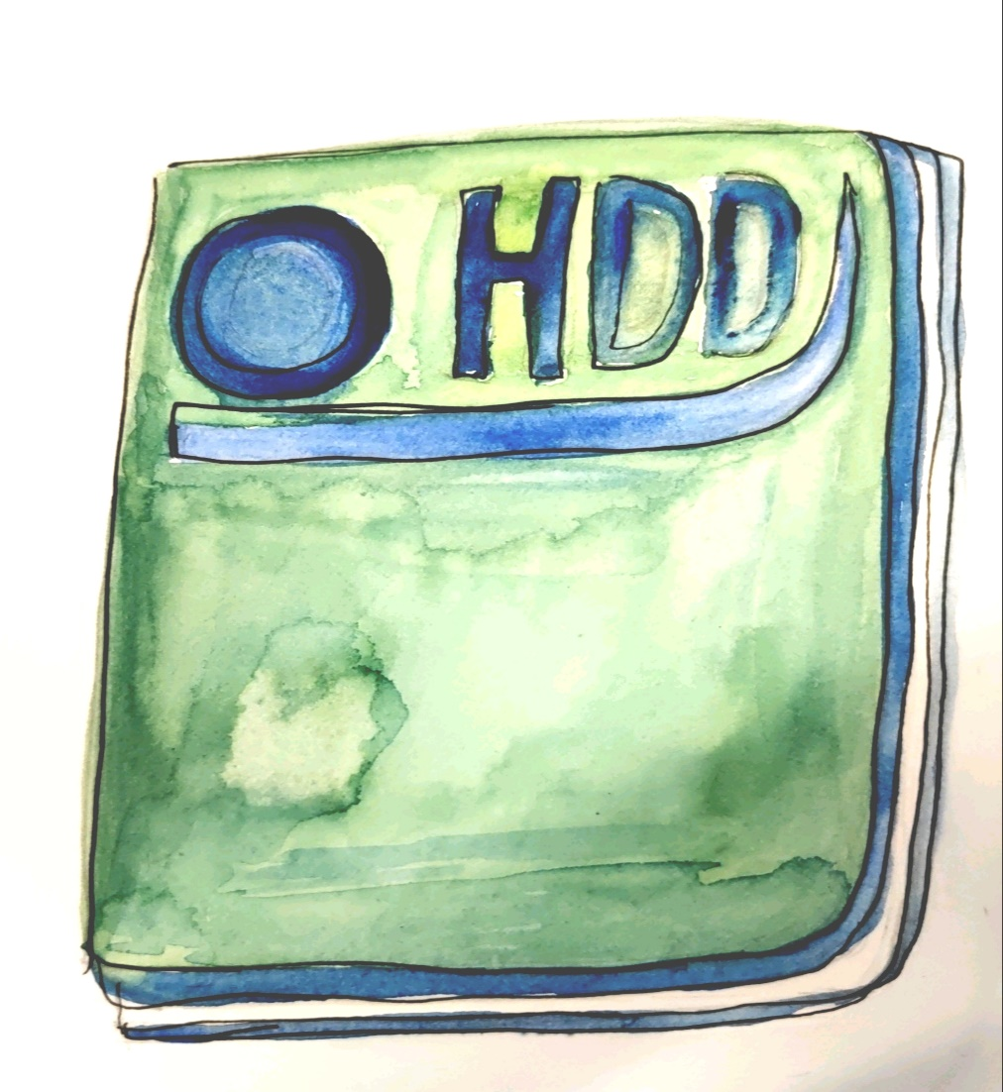
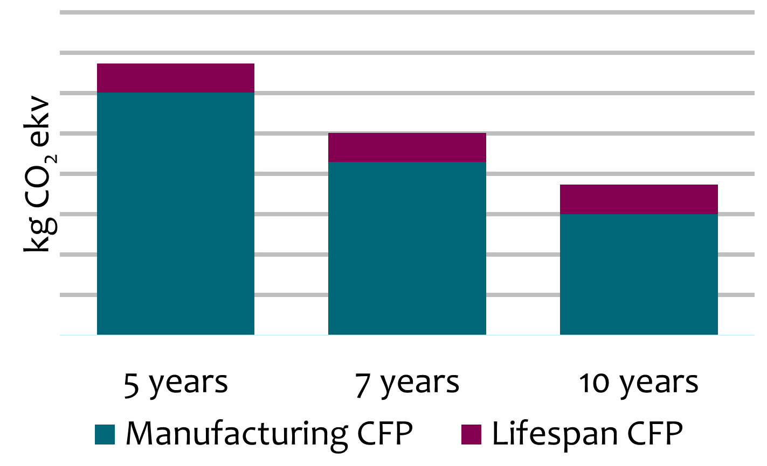
A Generic Carbon Footprint Model
Generic model
21169
kg CO₂ekv
Servers use components with an in-body carbon footprint that is reported by at least one vendor. These values can be turned into a generic server component in-body carbon footprint calculation.​
Our Data Centers:
A: 1.05
B: 1.2
C: 2
Annual CPF / TiB of the DPS in Finland
60 kg CO₂
CFP_{tot} = Σ (Q + E · PUE · C)
37kg CO₂
Finnish hydropower
24 kg CO₂ekv/
MWh
2020 12TB Seagate HDD
2024 16TB Seagate HDD
CFP_{tot} | Total annual carbon footprint
Q | Carbon footprint of hardware manufacturing, disposal and logistics (per year)
E | Electricity used to run the DPS platform
PUE | Datacenter power usage efficiency
C | Electricity production carbon footprint
Lifespan Impact on the Annual CFP
Average figures from data published by DELL & HPE Enclosure 15 kg CO₂ekv
Fan 3 kg CO₂ekv
Power supply unit 19 kg CO₂ekv
Mainboard (2x CPU + 192GB RAM) 488 kg CO₂ekv
Solid state drive (<500GB) 19 kg CO₂ekv
Hard drive 37-60 kg CO₂ekv
Daughterboard 170 kg CO₂ekv
Risk of data loss
Mikko Tiainen, Heikki Helin, Johan Kylander, Juha Lehtonen, CSC – IT Center for Science Ltd, https://digitalpreservation.fi

Slide 2
A Generic Carbon Footprint Model
Generic model
21169
kg CO₂ekv
Servers use components with an in-body carbon footprint that is reported by at least one vendor. These values can be turned into a generic server component in-body carbon footprint calculation.​
Our Data Centers:
A: 1.05
B: 1.2
C: 2
Annual CPF / TiB of the DPS in Finland
Emissions of Energy Sources
60 kg CO₂
CFP_{tot} = Σ (Q + E · PUE · C)
37kg CO₂
Finnish hydropower
24 kg CO₂ekv/
MWh
2020 12TB Seagate HDD
2024 16TB Seagate HDD
CFP_{tot} | Total annual carbon footprint
Q | Carbon footprint of hardware manufacturing, disposal and logistics (per year)
E | Electricity used to run the DPS platform
PUE | Datacenter power usage efficiency
C | Electricity production carbon footprint
Lifespan Impact on the Annual CFP
Average figures from data published by DELL & HPE Enclosure 15 kg CO₂ekv
Fan 3 kg CO₂ekv
Power supply unit 19 kg CO₂ekv
Mainboard (2x CPU + 192GB RAM) 488 kg CO₂ekv
Solid state drive (<500GB) 19 kg CO₂ekv
Hard drive 37-60 kg CO₂ekv
Daughterboard 170 kg CO₂ekv
Risk of data loss
Mikko Tiainen, Heikki Helin, Johan Kylander, Juha Lehtonen, CSC – IT Center for Science Ltd, https://digitalpreservation.fi

Slide 3
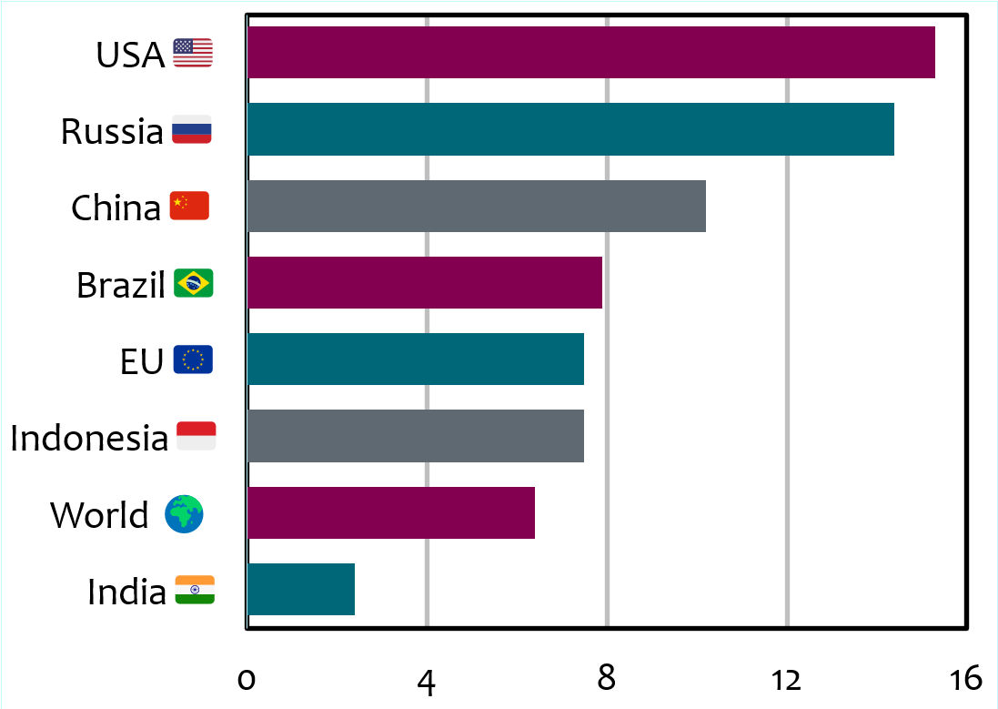
A Generic Carbon Footprint Model
Generic model
21169
kg CO₂ekv
Servers use components with an in-body carbon footprint that is reported by at least one vendor. These values can be turned into a generic server component in-body carbon footprint calculation.​
Our Data Centers:
A: 1.05
B: 1.2
C: 2
Annual CPF / TiB of the DPS in Finland
Emissions in 2021 (t CO₂ekv / capita)
60 kg CO₂
CFP_{tot} = Σ (Q + E · PUE · C)
37kg CO₂
Finnish hydropower
24 kg CO₂ekv/
MWh
2020 12TB Seagate HDD
2024 16TB Seagate HDD
CFP_{tot} | Total annual carbon footprint
Q | Carbon footprint of hardware manufacturing, disposal and logistics (per year)
E | Electricity used to run the DPS platform
PUE | Datacenter power usage efficiency
C | Electricity production carbon footprint
Lifespan Impact on the Annual CFP
Average figures from data published by DELL & HPE Enclosure 15 kg CO₂ekv
Fan 3 kg CO₂ekv
Power supply unit 19 kg CO₂ekv
Mainboard (2x CPU + 192GB RAM) 488 kg CO₂ekv
Solid state drive (<500GB) 19 kg CO₂ekv
Hard drive 37-60 kg CO₂ekv
Daughterboard 170 kg CO₂ekv
Risk of data loss
Mikko Tiainen, Heikki Helin, Johan Kylander, Juha Lehtonen, CSC – IT Center for Science Ltd, https://digitalpreservation.fi

Slide 4
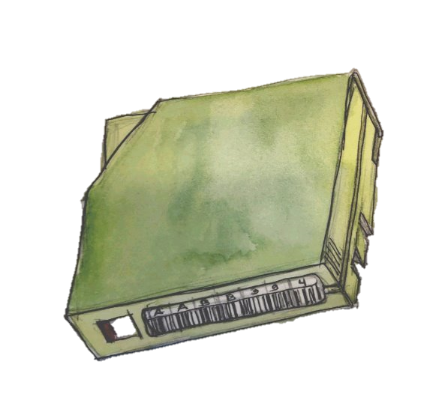
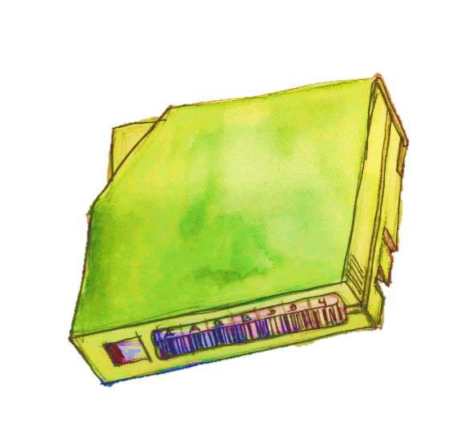
A Generic Carbon Footprint Model
Generic model
21169
kg CO₂ekv
Servers use components with an in-body carbon footprint that is reported by at least one vendor. These values can be turned into a generic server component in-body carbon footprint calculation.​
Our Data Centers:
A: 1.05
B: 1.2
C: 2
Annual CPF / TiB of the DPS in Finland
Our 7.5 PiB DPS Platform​
CFP_{tot} = Σ (Q + E · PUE · C)
60 kg CO₂
37kg CO₂
Vendors: HPE, IBM & Inspur
37kg CO₂
Finnish hydropower
24 kg CO₂ekv/
MWh
2020 12TB Seagate HDD
2024 16TB Seagate HDD
CFP_{tot} | Total annual carbon footprint
Q | Carbon footprint of hardware manufacturing, disposal and logistics (per year)
E | Electricity used to run the DPS platform
PUE | Datacenter power usage efficiency
C | Electricity production carbon footprint
Lifespan Impact on the Annual CFP
Average figures from data published by DELL & HPE Enclosure 15 kg CO₂ekv
Fan 3 kg CO₂ekv
Power supply unit 19 kg CO₂ekv
Mainboard (2x CPU + 192GB RAM) 488 kg CO₂ekv
Solid state drive (<500GB) 19 kg CO₂ekv
Hard drive 37-60 kg CO₂ekv
Daughterboard 170 kg CO₂ekv
+
LTO8
Number of HDDs: 1200
Number of SSDs: 119
Number of servers: 43
Number of tape libraries: 5
Number of tape drives: 35
Number of tapes: 1126
Ingest includes a thorough validation of submitted content on servers
LTO9
LTO8
Risk of data loss
Mikko Tiainen, Heikki Helin, Johan Kylander, Juha Lehtonen, CSC – IT Center for Science Ltd, https://digitalpreservation.fi

Slide 5
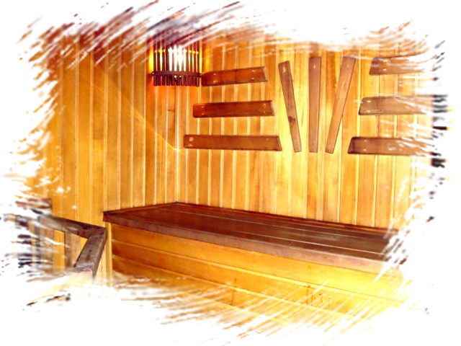
A Generic Carbon Footprint Model
Generic model
21169
kg CO₂ekv
Servers use components with an in-body carbon footprint that is reported by at least one vendor. These values can be turned into a generic server component in-body carbon footprint calculation.​
Our Data Centers:
A: 1.05
B: 1.2
C: 2
Annual CPF / TiB of the DPS in Finland
60 kg CO₂
CFP_{tot} = Σ (Q + E · PUE · C)
37kg CO₂
21169
kg CO₂ekv
Finnish hydropower
24 kg CO₂ekv/
MWh
2020 12TB Seagate HDD
2024 16TB Seagate HDD
We could make 9 800 000 cups of coffee per year instead of doing digital preservation
CFP_{tot} | Total annual carbon footprint
Q | Carbon footprint of hardware manufacturing, disposal and logistics (per year)
E | Electricity used to run the DPS platform
PUE | Datacenter power usage efficiency
C | Electricity production carbon footprint
Lifespan Impact on the Annual CFP
Average figures from data published by DELL & HPE Enclosure 15 kg CO₂ekv
Fan 3 kg CO₂ekv
Power supply unit 19 kg CO₂ekv
Mainboard (2x CPU + 192GB RAM) 488 kg CO₂ekv
Solid state drive (<500GB) 19 kg CO₂ekv
Hard drive 37-60 kg CO₂ekv
Daughterboard 170 kg CO₂ekv
The total carbon footprint of the DPS in Finland
Risk of data loss
We could also heat 35 000 saunas per year with the same CFP
Mikko Tiainen, Heikki Helin, Johan Kylander, Juha Lehtonen, CSC – IT Center for Science Ltd, https://digitalpreservation.fi

